Slide 1
Home Electric Consumption forecasting
Ali Ahammad

Slide 2


Objective
Building a prediction model to predict power consumption in every 15 minutes
Algorithms used MLP and SVM models and hyper tuned parameters
Datasets used from load Algarve forecasting using HEM where the data are already compiled, and parameters are selected

Slide 3
Datasets
Processing
Separated into two dataframe depending on the suffix 1 and 2 and drop the nan rows from suffix 1 dataframe
Concatenated two dataframes

Slide 4
Datasets
Daycode
DayCode has column elements: 0.05, 0.15, 0.25, 0.3, 0.35, 0.5, 0.8, 0.7, 1.0
Renamed the column name: “DayCode”,”Occupation”, “Power”
Then normality test
Then supervised data for next 48 timestamps in 12 hours which would show every 15 minutes interval
Then the dataset is splited to train and test

Slide 5
Dataset normality test
For power column
Skewness for Power is 1.046 and kurtosis is 1.701
Performing Shapiro–Wilk test
Shapiro Test Statistic 0.93622
p-value 4.295927216204073e-34
Performing D'Agostino's K2 test
D'Agostino's K2 Test Statistic 500.32654
p-value 2.2671072101201093e-109
Performing Anderson-Darling test
Anderson-Darling Test Statistic 37.10178617295105
At 15.0% significance level, critical value is 0.575
At 10.0% significance level, critical value is 0.655
At 5.0% significance level, critical value is 0.786
At 2.5% significance level, critical value is 0.917
At 1.0% significance level, critical value is 1.091

Slide 6
Dataset normality test result
For power column
We can reject the null hypothesis (D'Agostino's K²), so our series is not normally distributed.
We can reject the null hypothesis (Anderson-Darling), so our series is not normally distributed.
Overall normality result for 'Power': Not Normal
Kurtosis of normal distribution: 1.6963600512675807
Skewness of normal distribution: 1.04577179073994

Slide 7
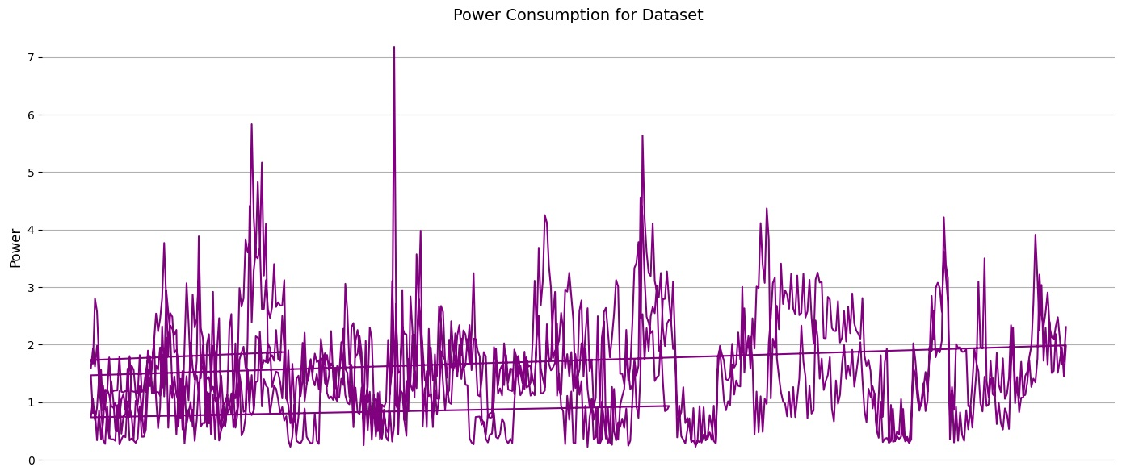
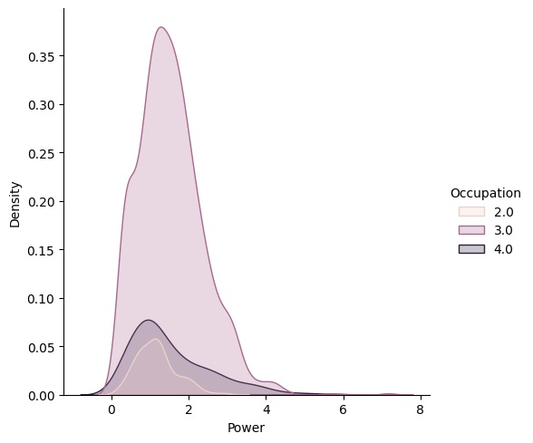
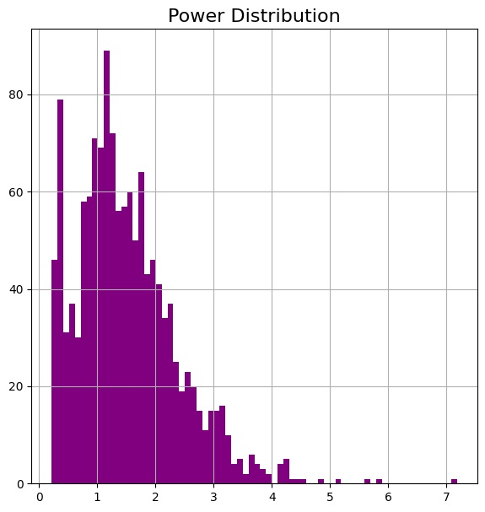
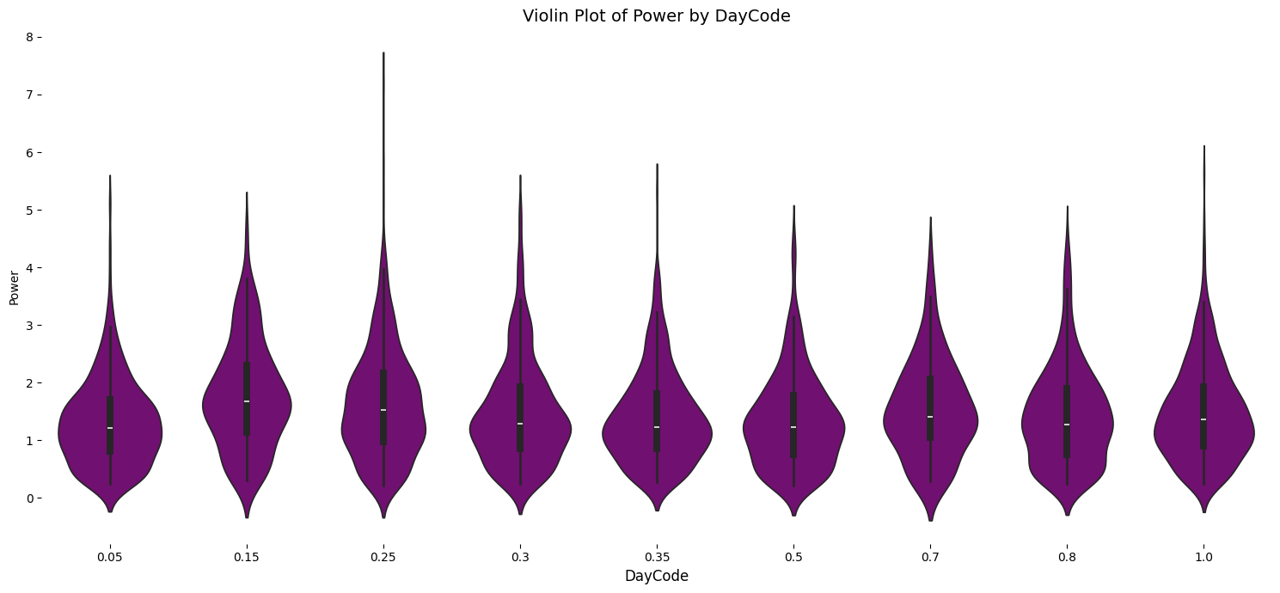
Statistics plots

Slide 8
Scaling and sampling
Used robustScaler() because it is robust to outliers in the sense that adding or removing outliers in the training set will yield approximately the same transformation
Then we have sampled the dataset with lookback=380 and horizon 48
For lookback, 24 hours * 4 (15-minute intervals per hour) the dataset is sampled every 15 minutes, so there are 4 samples per hour.For a 24-hour period, we need 24 hours * 4 samples/hour = 96 samples. By setting lookback = 380, we are considering a period of 380 / 4 ≈ 95 hours, which is approximately 4 days' worth of historical data.
For horizon, The dataset is sampled every 15 minutes, so there are 4 samples per hour. To predict for the next 12 hours, we need 12 hours * 4 samples/hour = 48 samples. By setting horizon = 48, we are defining that the model should predict the next 48 samples, which corresponds to 12 hours ahead.

Slide 9
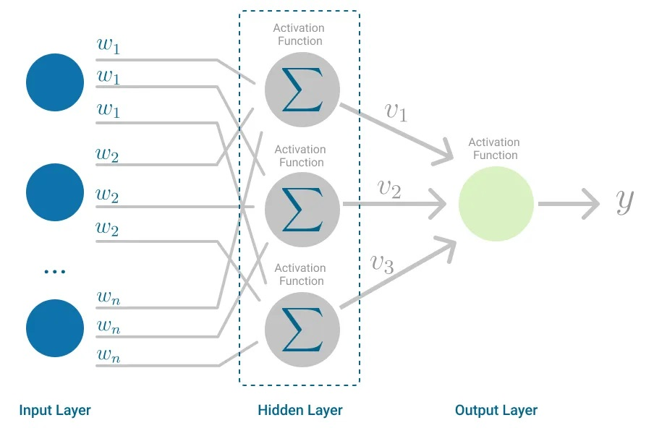
Model 1: Multi layered perceptron
Hidden layer sizes= 100,50 (the number of neurons)
Maximum iteration= 500
Random state=42
The activation function for hidden layer is by default relu
Solver for weight optimization is adam
Early_stopping is false

Slide 10
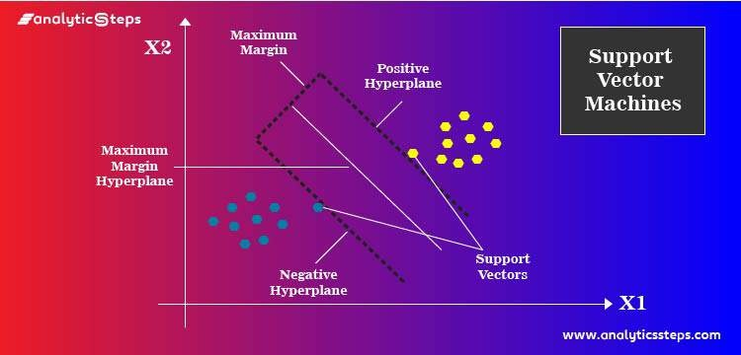
Algorithm 2: Support Vector Machine Algorithm
‘rbf’ is used for kernel type.
Other parameters are by default chosen such as gamma would be scale and it uses 1 / (n_features * X.var()) as value of gamma
Regularization parameter C is 1.0
Max_iter is hard limit on iteration within solver or -1 for no limit

Slide 11
Output comparison between MLP and SVM
In both power and occupation models, SVR outperforms MLP, as it has lower MSE values.
SVR performs better in both power and occupation models due to its lower MAE.
For R² measures , both models perform poorly for power prediction. However, SVR is better for occupation prediction (though still not ideal).
For explained variance, SVR slightly outperforms MLP for power prediction, but neither model explains much variance. For occupation, both models fail to capture any variance.
 | MLP Power | SVR Power | MLP Occupation | SVR Occupation
Mean Squared Error | 1.02 | 0.73 | 0.09 | 0.03
Mean Absolute Error | 0.84 | 0.72 | 0.23 | 0.14
R-squared | -2.00 | -1.15 | 0.00 | 0.00
Explained Variance | -0.56 | -0.13 | 0.00 | 0.00
In short, SVR consistently performs better than MLP across all metrics, especially for power prediction.
However, both models struggle with occupation prediction, as indicated by low R² and explained variance.

Slide 12
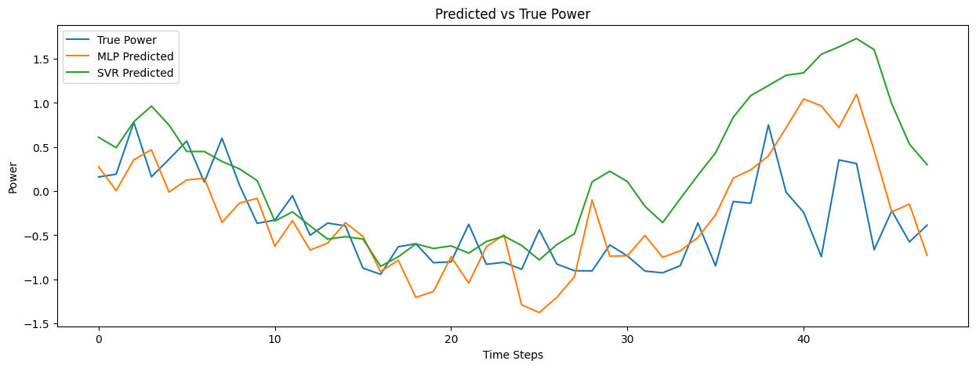
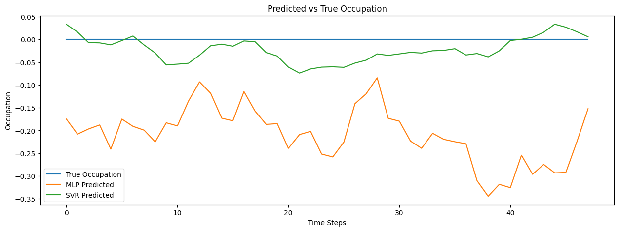
Graph comparison between MLP and SVM

Slide 13
Hyper-parameter tuning
SVM
MLP classifier
Hidden layer sizes: (50,), (100,), (100, 50), (50, 100)
Max_iter: 200,500
alpha: 0.0001, 0.001, 0.01,
learning_rate: 'constant', 'adaptive'
kernel: rbf, linear,
C: 0.1, 1, 10,
gamma: scale, auto

Slide 14
Output comparison between MLP and SVM after tuning
 | MLP Power | SVR Power | MLP Occupation | SVR Occupation
Mean Squared Error | 1.07 | 0.73 | 0.05 | 0.03
Mean Absolute Error | 0.86 | 0.72 | 0.17 | 0.14
R-squared | -2.14 | -1.15 | 0.00 | 0.00
Explained Variance | -0.61 | -0.13 | 0.00 | 0.00
Mean Squared Error (MSE): Both models show improvements in power prediction, with SVR maintaining its lower MSE. For occupation prediction, both models have lower MSE values, but SVR still performs better.
Mean Absolute Error (MAE): SVR continues to outperform MLP in both power and occupation prediction. The MAE values are lower for both models in the occupation task.
R-squared (R²):The R² values remain negative for both power and occupation prediction, indicating poor model fit. SVR is still the better performer, but neither model explains much variance.
Explained Variance: SVR maintains its advantage in explained variance for power prediction. Unfortunately, both models fail to capture any variance in occupation prediction.
SVR remains the better model overall, especially for power prediction.

Slide 15
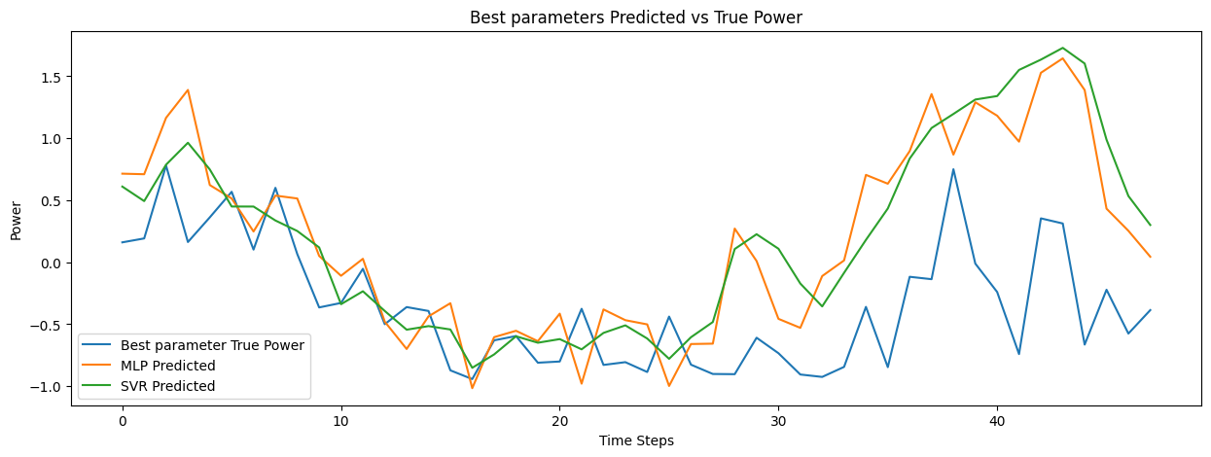
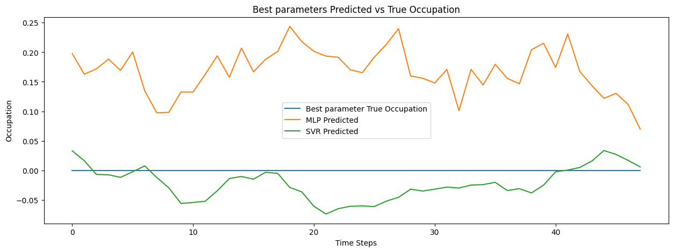
Graph comparison between MLP and SVM after tuning

Slide 16
Thank you
Ali Ahammad
Any Questions???

